Slide 1
Solar cells

Slide 2
Contents
solar cell
Chlorophyll
Solar panels
Organic Solar Cell

Slide 3
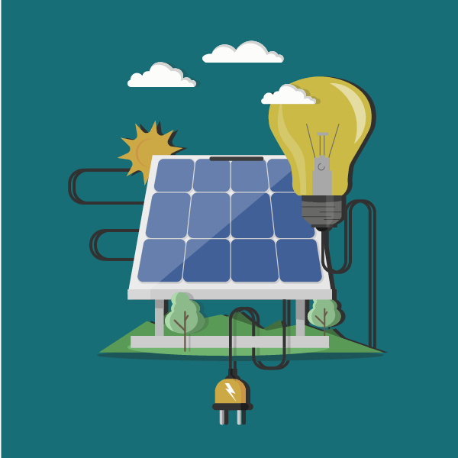
A solar cell, or photovoltaic cell, is an electrical device that converts the energy of light directly into electricity by the photovoltaic effect, which is a physical and chemical phenomenon.

Slide 4
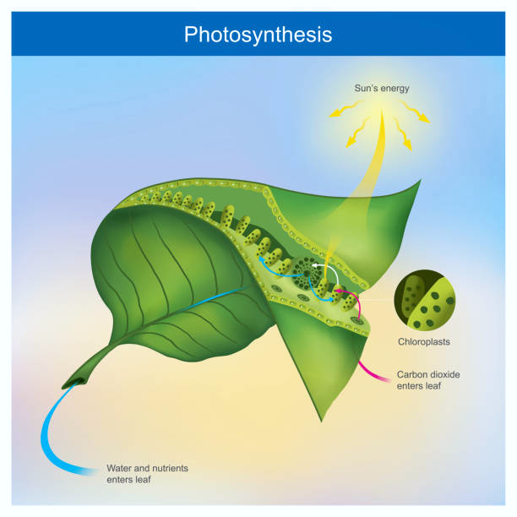
Chlorophyll, a natural pigment that is stimulated by sunlight.

Slide 5
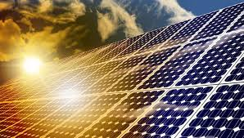
Solar
panels

Slide 7
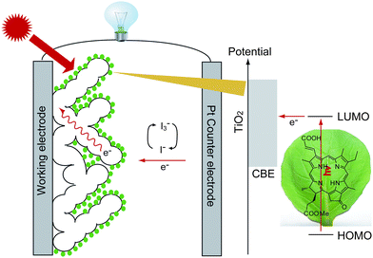
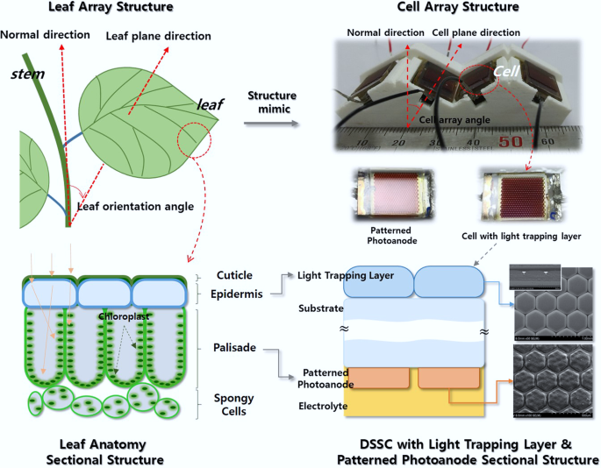
Chlorophyll as Photosensitizer
in Dye-Sensitized Solar Cells

Slide 8
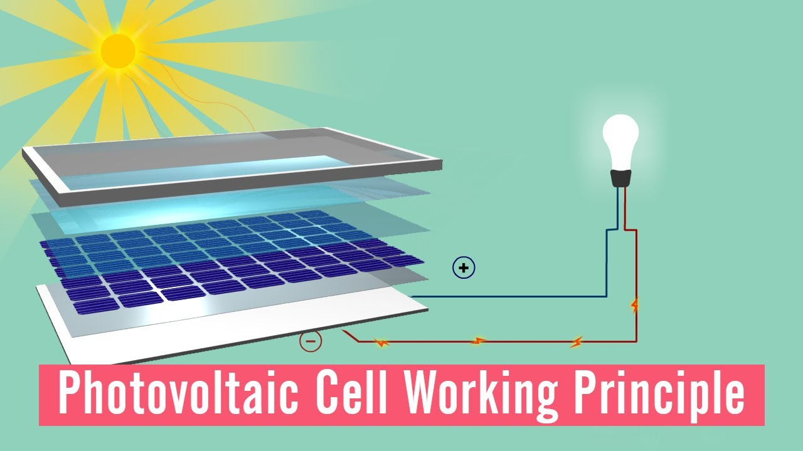
Solar windows create electricity that can be put back into the National Grid and used to cover up to half of our heating expense.

Slide 9
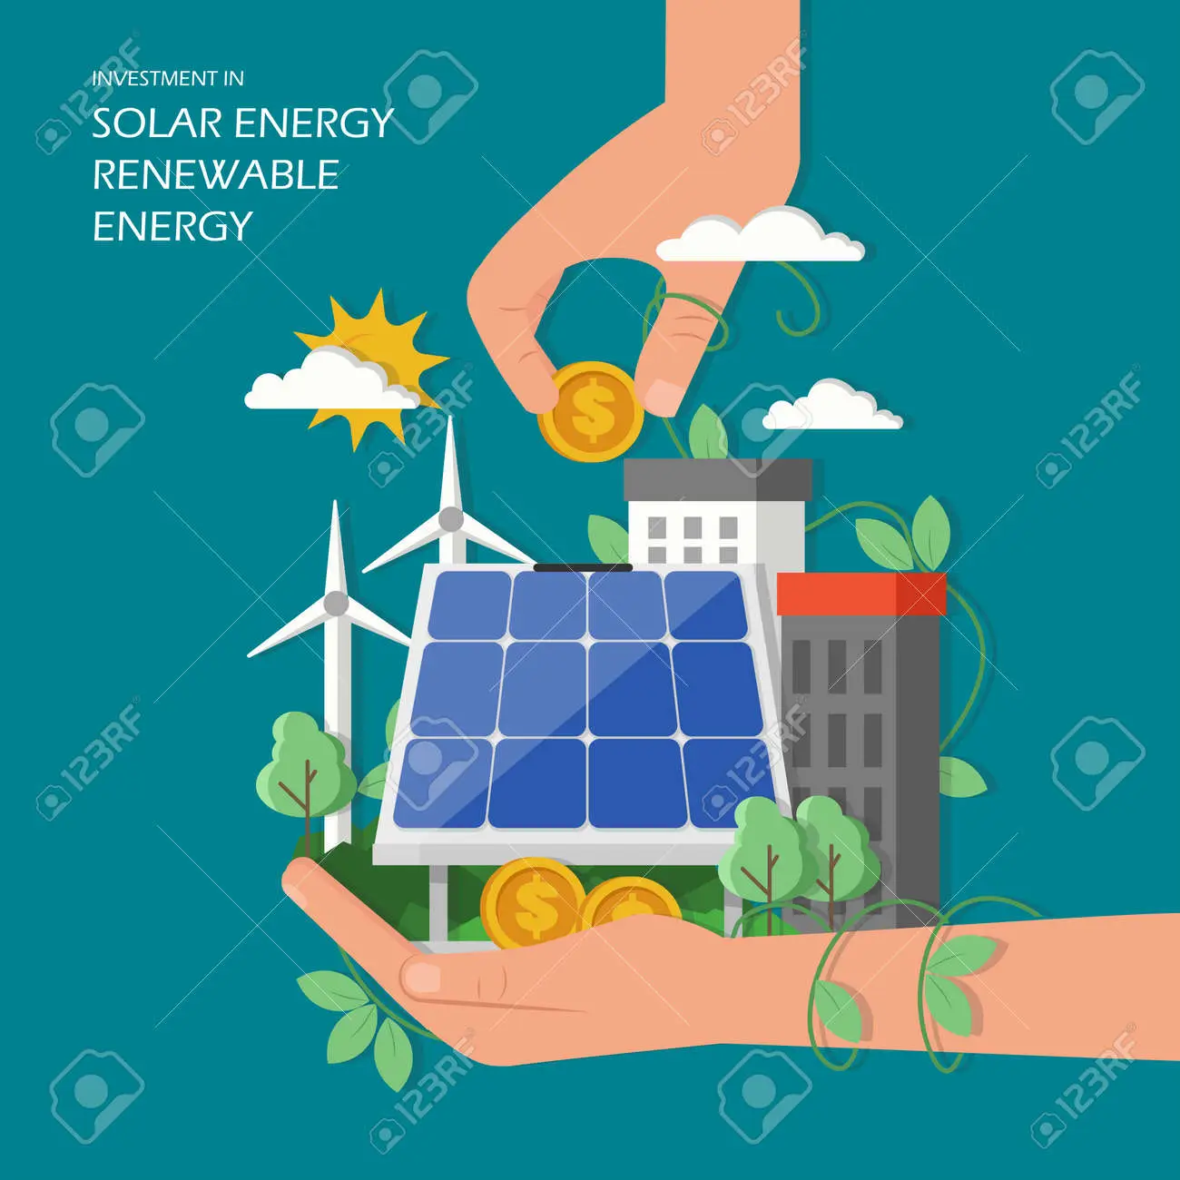
Save money

Slide 10
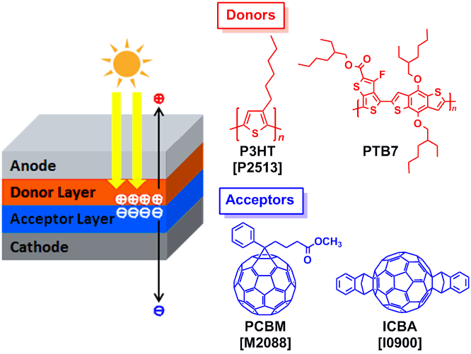
Organic Solar Cell

Slide 11
Thanks for your attention!
Kalina
Chuchukova

